Slide 1

Imputation strategies for risk prediction models based on Electronic Health Records
Lee Lok hang Toby

Slide 2
Missingness of data
Missing at random (MAR)
Missing not at random (MNAR)
Missing completely at random (MCAR)

Slide 3
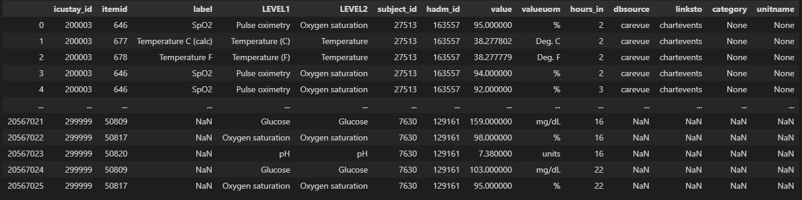
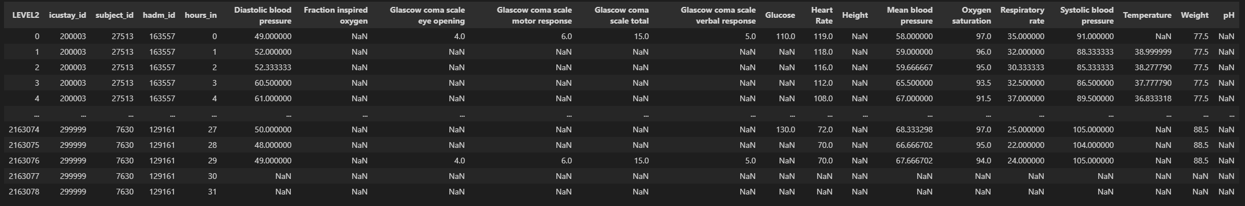

Slide 4
Univariate VS multiVariate
Features
Var 1
Var 2
Var 3
Var 4
Var 5
Patient 1
1st Hour
2nd Hour
3rd Hour
Patient 2
1st Hour
2nd Hour
3rd Hour
Features
Var 1
Var 2
Var 3
Var 4
Var 5
Patient 1
1st Hour
2nd Hour
3rd Hour
Patient 2
1st Hour
2nd Hour
3rd Hour

Slide 5


Mean impuation
Features
Features
Var 1
Var 2
Var 3
Var 4
Var 5
Var 1
Var 2
Var 3
Var 4
Var 5
0.8 | 0.6 | 0.5 | 0.3
0.5 | 0.5 |  | 0.7 | 0.2
 | 0.7 | 0.7 | 0.7 | 0.4
0.6 | 0.9 | 0.4 | 0.6 | 0.6
0.4 | 0.3 | 0.6 |  | 0.7
0.7 | 0.1 | 0.5 | 0.5 | 0.3
Impute value using calculated mean and repeat for all variables across the data
0.8 | 0.6 | 0.5 | 0.3
0.5 | 0.5 |  | 0.7 | 0.2
0.6 | 0.7 | 0.7 | 0.7 | 0.4
0.6 | 0.9 | 0.4 | 0.6 | 0.6
0.4 | 0.3 | 0.6 |  | 0.7
0.7 | 0.1 | 0.5 | 0.5 | 0.3
Patient 1
1st Hour
2nd Hour
3rd Hour
Patient 2
1st Hour
2nd Hour
3rd Hour
Calculate the mean of Var 1
Calculate the mean of Var 3
$$mean= \frac{0.8 + 0.5 + 0.6 + 0.4 + 0.7}{5}=0.6$$
$$mean= \frac{0.5 + 0.7 + 0.4 + 0.6 + 0.5}{5}=0.54$$

Slide 6
Most Frequent imputation
Features
Features
Var 1
Var 2
Var 3
Var 4
Var 5
Var 1
Var 2
Var 3
Var 4
Var 5
0.8 | 0.6 | 0.5 | 0.3
0.5 | 0.5 |  | 0.7 | 0.2
 | 0.7 | 0.7 | 0.7 | 0.4
0.6 | 0.9 | 0.4 | 0.6 | 0.6
0.4 | 0.3 | 0.6 |  | 0.7
0.6 | 0.1 | 0.5 | 0.5 | 0.3
Impute value using most frequent value and repeat across all features
0.8 | 0.6 | 0.5 | 0.3
0.5 | 0.5 |  | 0.7 | 0.2
0.6 | 0.7 | 0.7 | 0.7 | 0.4
0.6 | 0.9 | 0.4 | 0.6 | 0.6
0.4 | 0.3 | 0.6 |  | 0.7
0.7 | 0.1 | 0.5 | 0.5 | 0.3
Patient 1
1st Hour
2nd Hour
3rd Hour
Patient 2
1st Hour
2nd Hour
3rd Hour
Count the occurrence of each value in Var 1
Count the occurrence of each value in Var 3
0.8 | 0.5 | 0.6 | 0.4
1 | 1 | 2 | 1
0.6 is most frequent
0.5 | 0.7 | 0.4 | 0.6
2 | 1 | 1 | 1
0.5 is most frequent

Slide 7

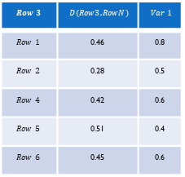
KNN impuation
Repeat for all missing values
Features
Var 1
Var 2
Var 3
Var 4
Var 5
0.8 | 0.6 | 0.5 | 0.3
0.5 | 0.5 |  | 0.7 | 0.2
 | 0.7 | 0.7 | 0.7 | 0.4
0.6 | 0.9 | 0.4 | 0.6 | 0.6
0.4 | 0.3 | 0.6 |  | 0.7
0.6 | 0.1 | 0.5 | 0.5 | 0.3
$$Row 3$$ | $$D(Row3, RowN)$$ | $$Var 1$$
$$Row 1$$ | 0.46 | 0.8
$$Row 2$$ | 0.28 | 0.5
$$Row 4$$ | 0.42 | 0.6
$$Row 5$$ | 0.51 | 0.4
$$Row 6$$ | 0.45 | 0.6
Row 1
Row 2
Calculate Euclidean Distance with all rows to create distance matrix
Row 3
Row 4
Row 5
Row 6
$$d\left(Row 3,Row 2\right)= \sqrt{{\left(0.7−0.5\right)}^{2}+{\left(0.7−0.7\right)}^{2}+{\left(0.4−0.2\right)}^{2}}=0.28$$
If k=3, closest neighbours: Row 2, 4, 1
$$d\left(Row 3,Row 4\right)= \sqrt{{\left(0.7−0.9\right)}^{2}+{\left(0.7−0.4\right)}^{2}+{\left(0.7−0.6\right)}^{2}{+ \left(0.4−0.6\right)}^{2}}=0.42$$
$$∴impute value=\frac{0.5+0.6+0.8}{3}=0.633$$
$$⋯$$
$$⋯$$

Slide 8

Multiple imputation with chained equation (MICE)
Features
Features
A | B | C | D | E
0.8 | 0.6 | 0.5 | 0.3
0.5 | 0.5 |  | 0.7 | 0.2
 | 0.7 | 0.7 | 0.7 | 0.4
0.6 | 0.9 | 0.4 | 0.6 | 0.6
0.4 | 0.3 | 0.6 |  | 0.7
0.6 | 0.1 | 0.5 | 0.5 | 0.3
A | B | C | D | E
0.8 | 0.6 | 0.5 | 0.3 | 0.44
0.5 | 0.5 | 0.54 | 0.7 | 0.2
0.58 | 0.7 | 0.7 | 0.7 | 0.4
0.6 | 0.9 | 0.4 | 0.6 | 0.6
0.4 | 0.3 | 0.6 | 0.56 | 0.7
0.6 | 0.1 | 0.5 | 0.5 | 0.3
Row 1
Row 2
Row 3
Row 4
Row 5
Row 6
Step 1: Create starting data with mean imputation.
Step 2: Starting from feature A, revert all missing values in A.
Features
Features
Step 5: Repeat step 2-4 for N iterations
A | B | C | D | E
0.8 | 0.6 | 0.5 | 0.3 | 0.44
0.5 | 0.5 | 0.54 | 0.7 | 0.2
 | 0.7 | 0.7 | 0.7 | 0.4
0.6 | 0.9 | 0.4 | 0.6 | 0.6
0.4 | 0.3 | 0.6 | 0.56 | 0.7
0.6 | 0.1 | 0.5 | 0.5 | 0.3
A | B | C | D | E
0.8 | 0.6 | 0.5 | 0.3 | 0.44
0.5 | 0.5 |  | 0.7 | 0.2
0.43 | 0.7 | 0.7 | 0.7 | 0.4
0.6 | 0.9 | 0.4 | 0.6 | 0.6
0.4 | 0.3 | 0.6 | 0.56 | 0.7
0.6 | 0.1 | 0.5 | 0.5 | 0.3
Row 1
Row 2
Features
Row 3
Var 1 | Var 2 | Var 3 | Var 4 | Var 5
0.8 | 0.6 | 0.5 | 0.3 | 0.33
0.5 | 0.5 | 0.55 | 0.7 | 0.2
0.43 | 0.7 | 0.7 | 0.7 | 0.4
0.6 | 0.9 | 0.4 | 0.6 | 0.6
0.4 | 0.3 | 0.6 | 0.35 | 0.7
0.6 | 0.1 | 0.5 | 0.5 | 0.3
Row 4
Row 1
Row 5
Row 2
Row 6
Row 3
Step 3: Using A as labels (Green) and everything else as features (Yellow), train the model to predict the missing value in A using values of the same row as features (Red).
Step 4: Repeat step 3 for feature B, C, D and E. Each time replacing the mean imputed values with model predicted values.
Row 4
Row 5
Row 6
Step 3: Split the rows with non missing value as train data, and rows with missing values as test data. Then train the regression model to predict the missing values.

Slide 9
Multiple Imputation with Denoising Autoencoders (MIDAS)
Forward pass, predict values
Features
A | B | C
0.7 | 0.5 | 0.4
0.8 | 0.5 | 0.4
 | 0.8 | 0.5
0.3 | 0.2 | 0.1
A | B | C
0.7 |  | 0.4
0.8 | 0.5
 | 0.8 | 0.5
0.3 | 0.2
A | B | C
0.7 | 0.53 | 0.4
0.8 | 0.5 | 0.42
0.5 | 0.8 | 0.5
0.3 | 0.2 | 0.13
A | B | C
0.8 | 0.5
0.6 | 0.2 | 0.3
0.8 | 0.4 | 0.6
0.5 | 0.4 | 0.3
 | 0.2 | 0.4
0.3 | 0.2 | 0.1
0.6 |  | 0.5
0.7 | 0.5 | 0.4
0.3 | 0.2 | 0.7
 | 0.4 | 0.6
0.8 | 0.5 | 0.4
0.7 | 0.5 | 0.7
A | B | C
0.8 | 0.5 | 0.42
0.6 | 0.2 | 0.3
0.8 | 0.4 | 0.6
0.5 | 0.4 | 0.3
0.82 | 0.2 | 0.4
0.3 | 0.2 | 0.1
0.6 | 0.4 | 0.5
0.7 | 0.5 | 0.4
0.3 | 0.2 | 0.7
0.42 | 0.4 | 0.6
0.8 | 0.5 | 0.4
0.7 | 0.5 | 0.7
Patient 1
1st Hour
2nd Hour
3rd Hour
4th Hour
Split and shuffle data into batches
Introduce extra missingness
Reconstruct and unshuffled data
Patient 2
A | B | C
0.5 | 0.4 | 0.3
0.6 |  | 0.5
0.8 | 0.4 | 0.6
0.6 | 0.2 | 0.3
A | B | C
0.5 | 0.4
0.6 |  | 0.5
 | 0.4 | 0.6
0.6 | 0.2
A | B | C
0.5 | 0.4 | 0.35
0.6 | 0.4 | 0.5
0.82 | 0.4 | 0.6
0.6 | 0.2 | 0.35
1st Hour
2nd Hour
Calculate loss by introduced missingness
3rd Hour
4th Hour
Patient 3
1st Hour
2nd Hour
A | B | C
 | 0.4 | 0.6
0.3 | 0.2 | 0.7
0.7 | 0.5 | 0.7
0.2 | 0.4
A | B | C
 | 0.4 | 0.6
0.3 | 0.2
 | 0.5 | 0.7
0.2 | 0.4
A | B | C
0.42 | 0.4 | 0.6
0.3 | 0.2 | 0.72
0.75 | 0.5 | 0.7
0.2 | 0.4 | 0.5
3rd Hour
4th Hour
Backpropagation

Slide 10
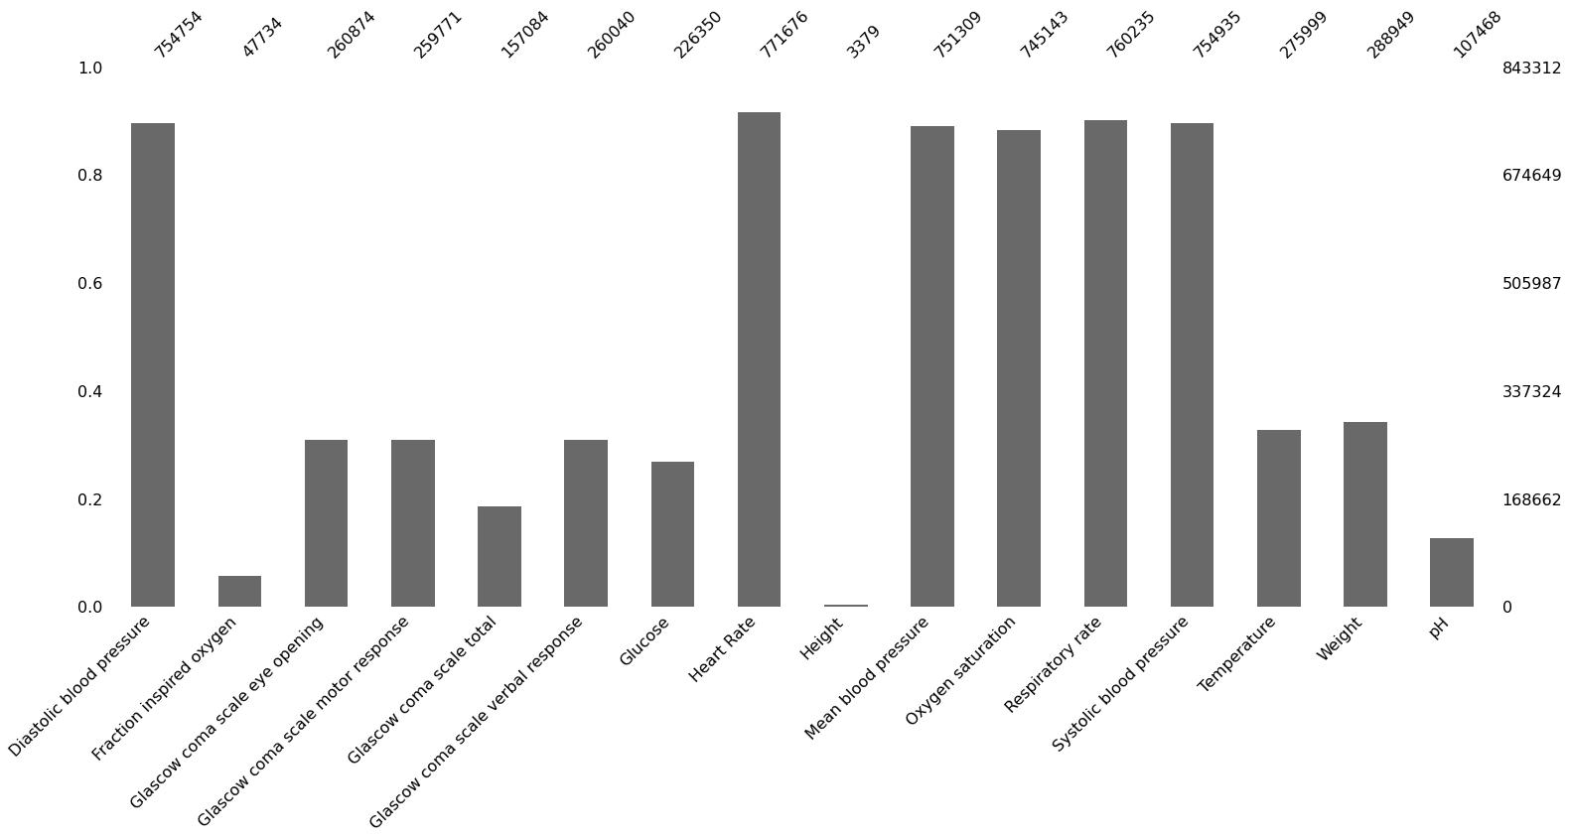
Missingness of the data
Percentage
Total number of values
number of values
Variables

Slide 11
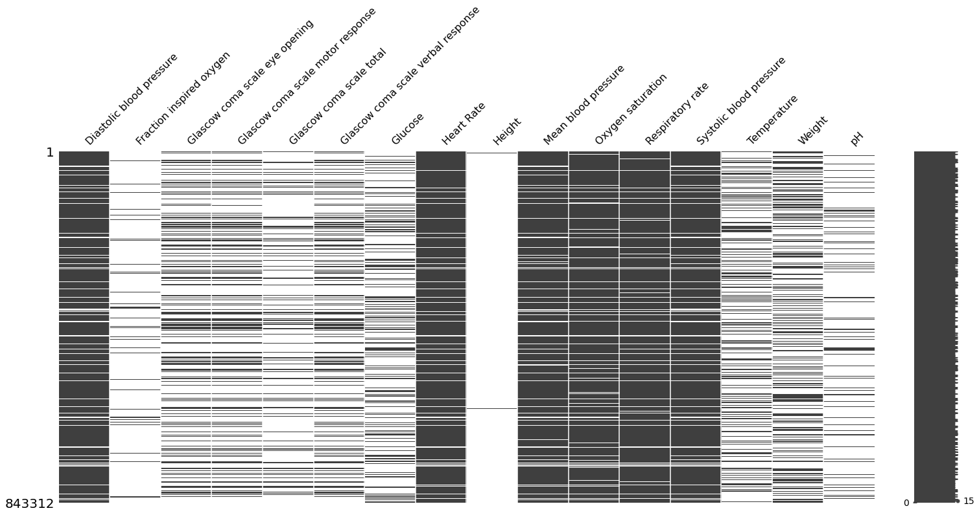
Missingness of the data
Variables
Index by rows

Slide 12
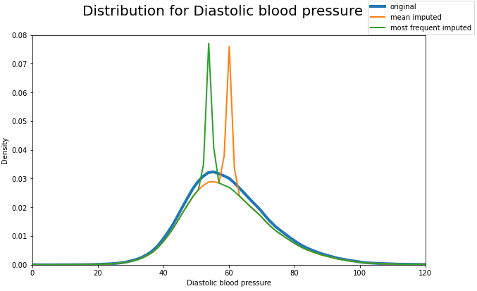
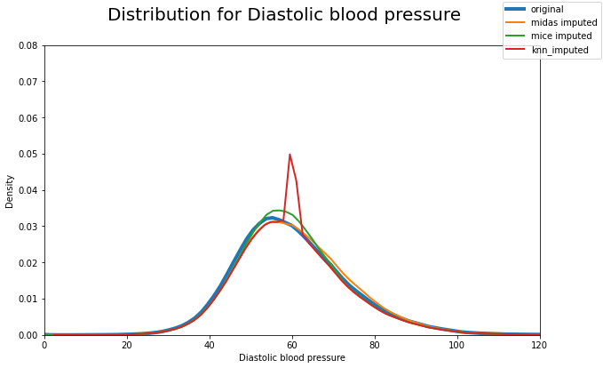

Slide 13
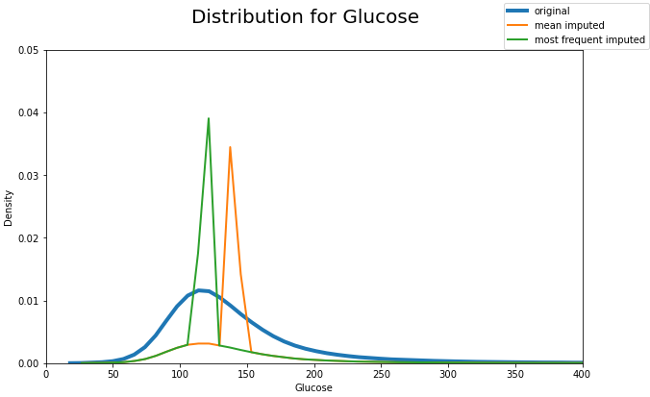
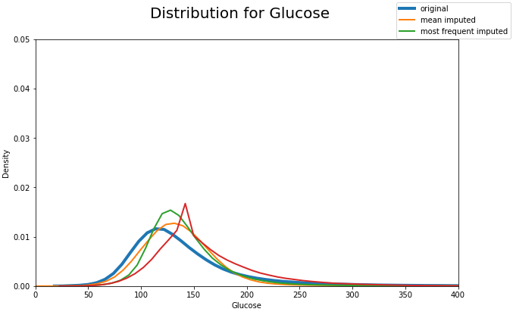

Slide 14
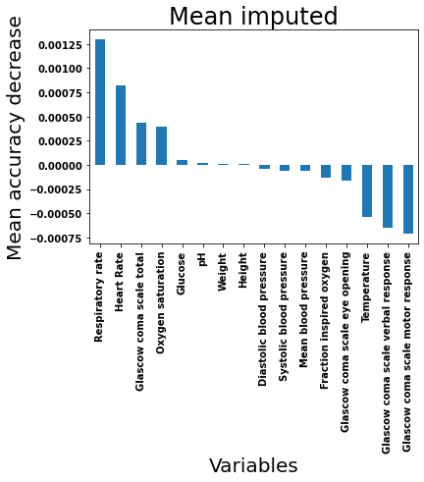
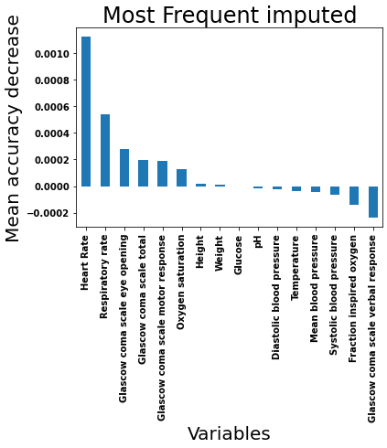
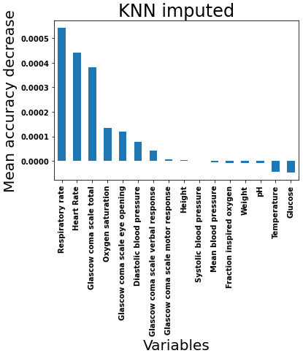
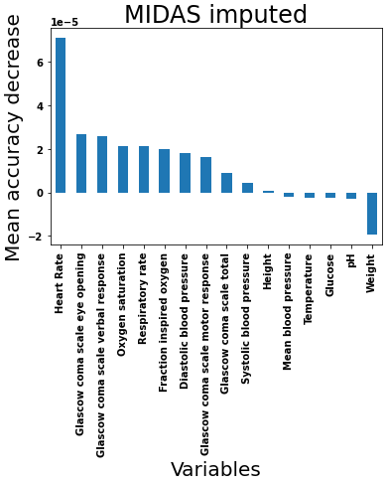
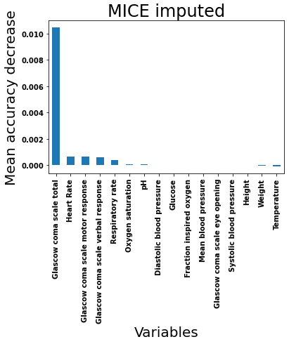
Feature importance

Slide 15
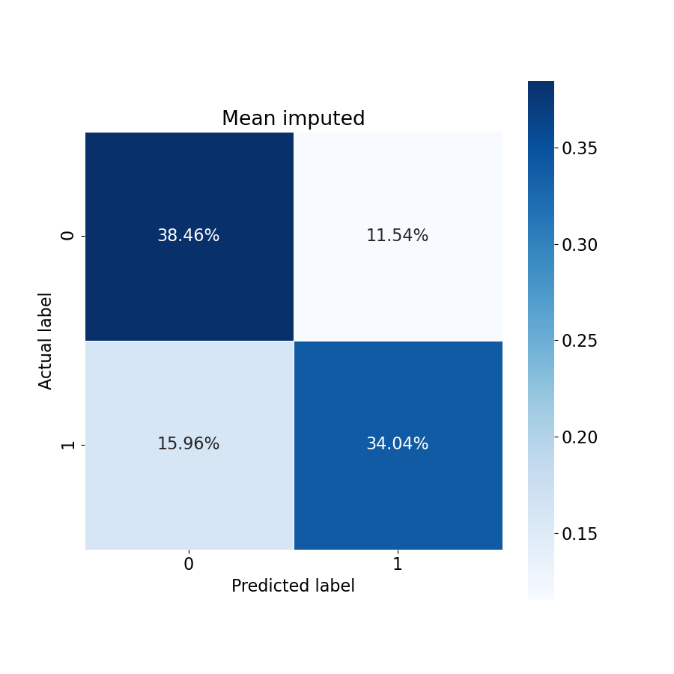
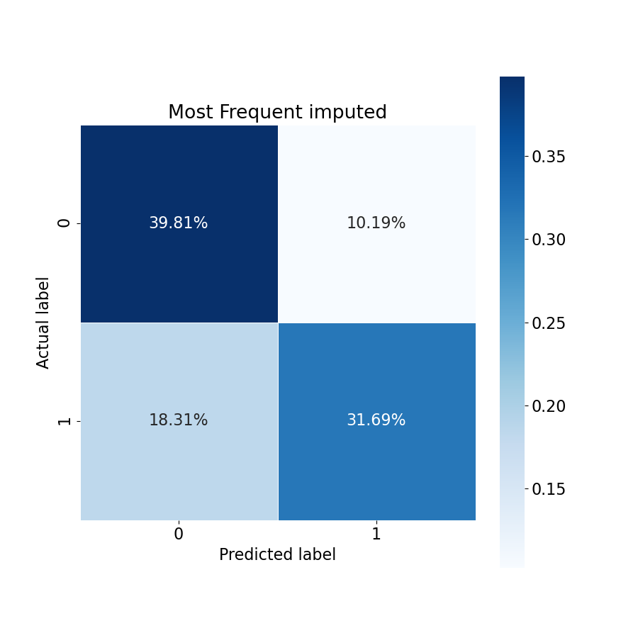



Logistic Regression (Confusion matrix)

Slide 16
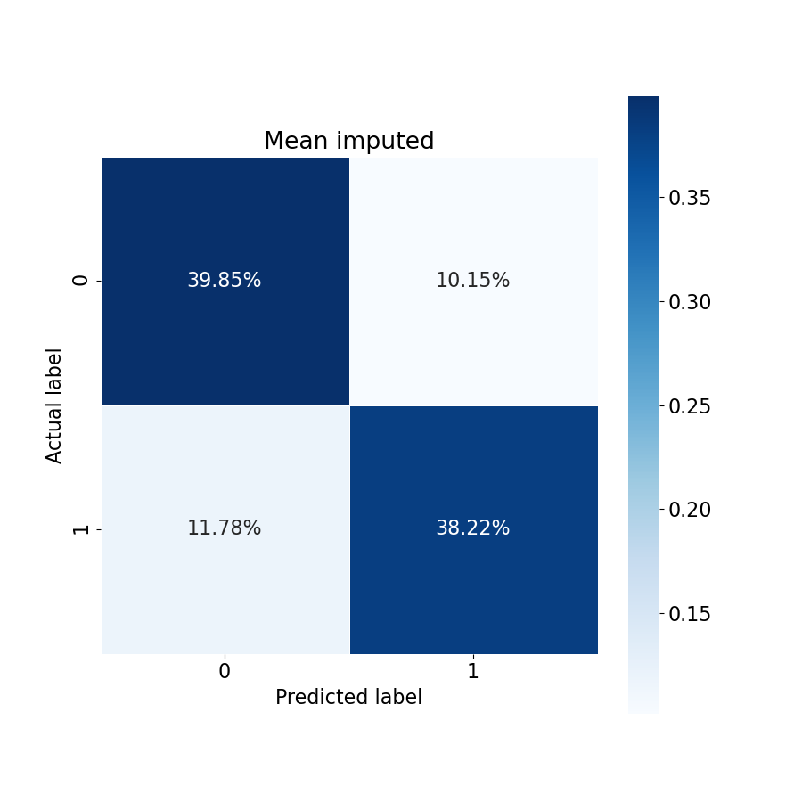
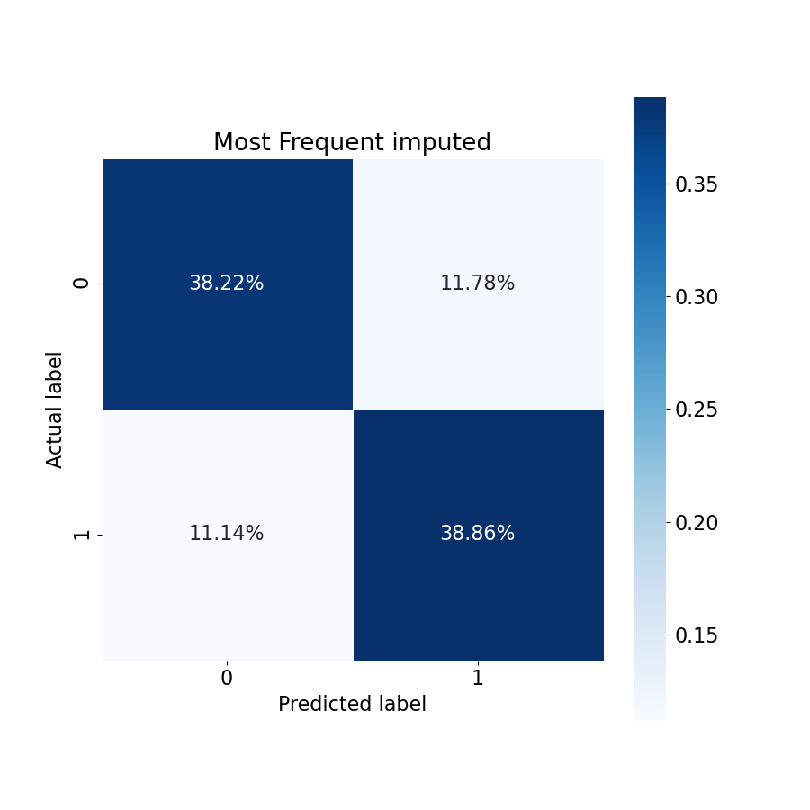
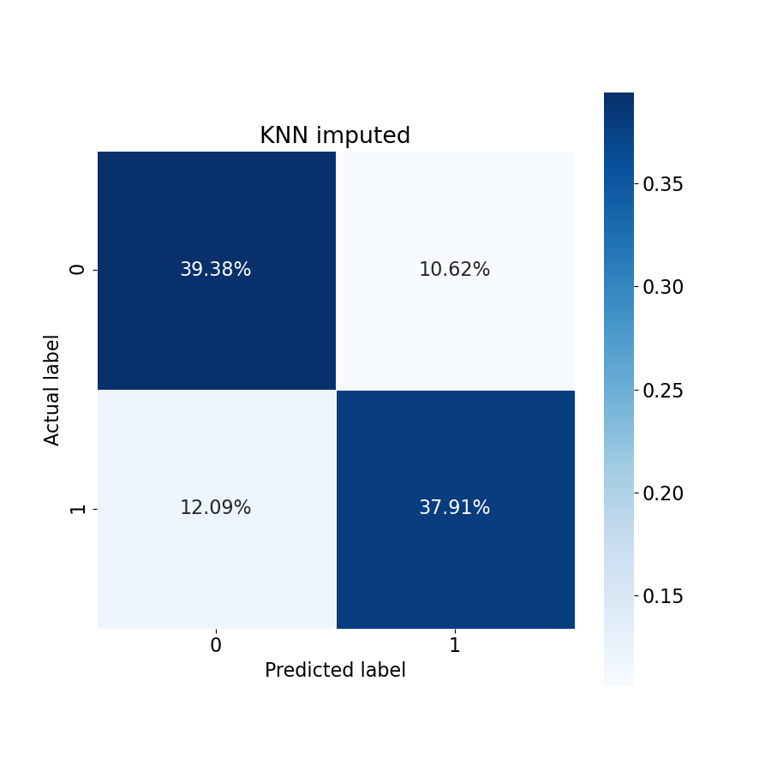

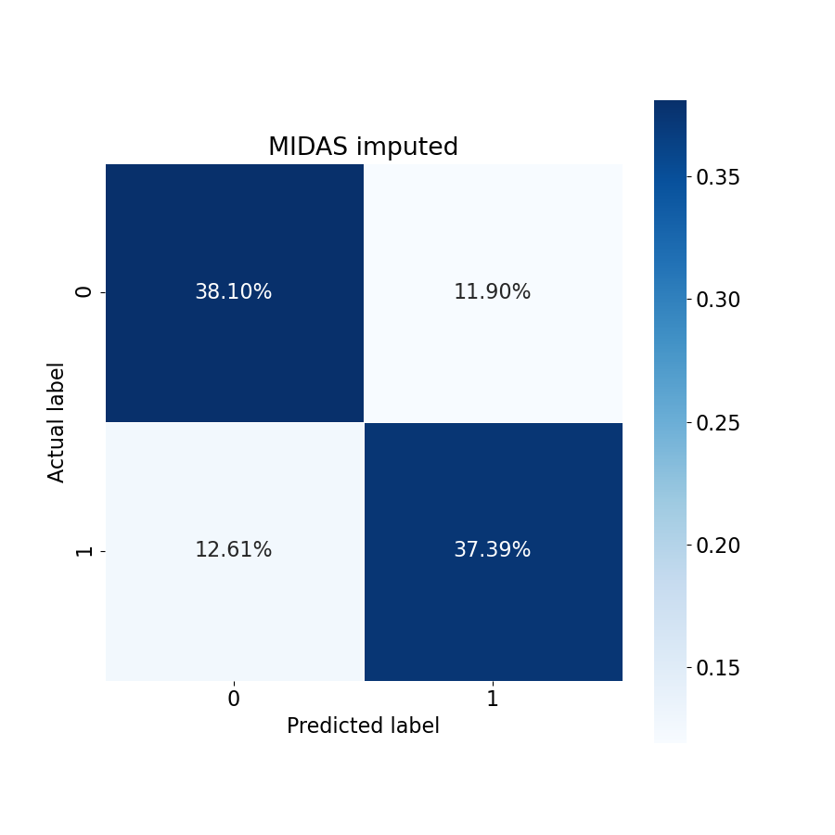
Random Forest (Confusion matrix)

Slide 17





Support Vector Classification (Confusion matrix)

Slide 18
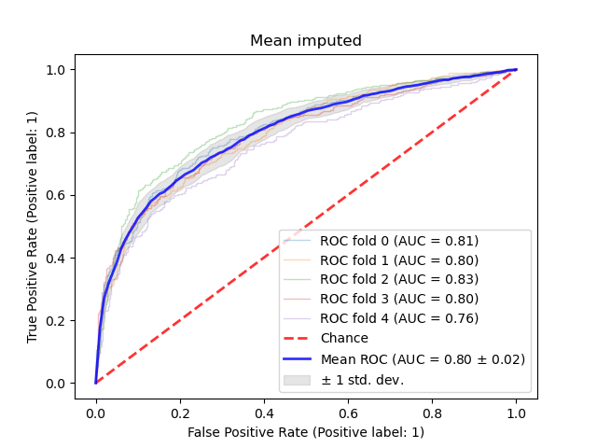
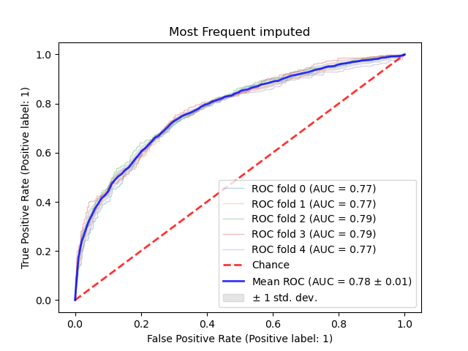
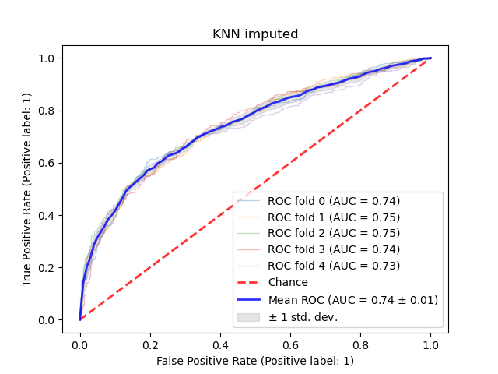
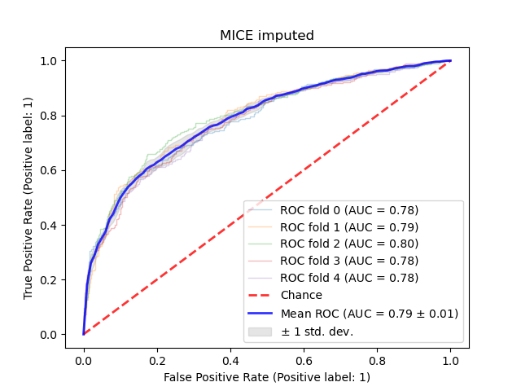
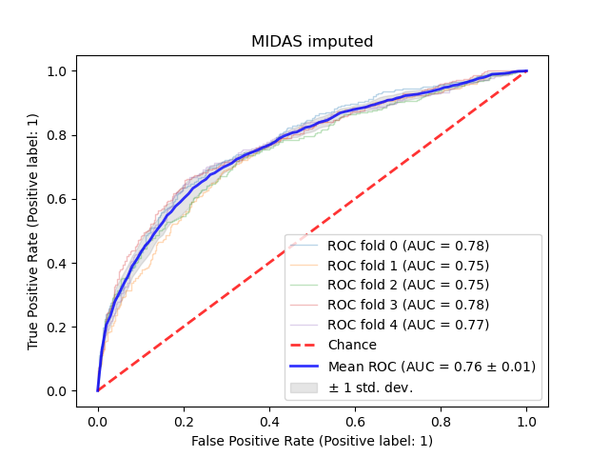
Logistic regression (ROC Curve)

Slide 19
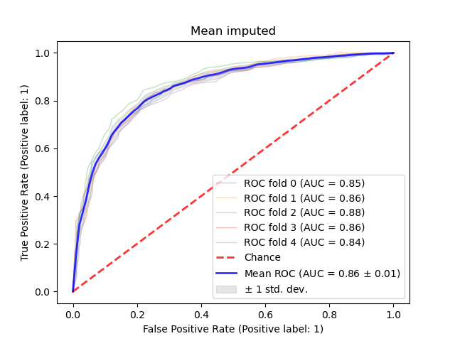
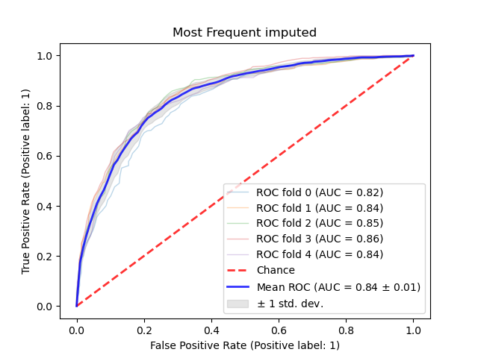
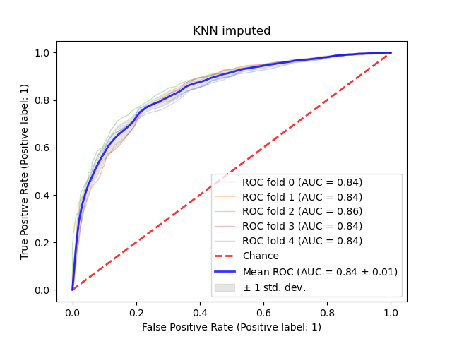
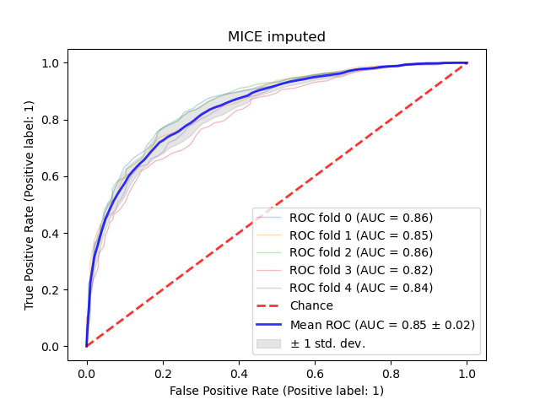
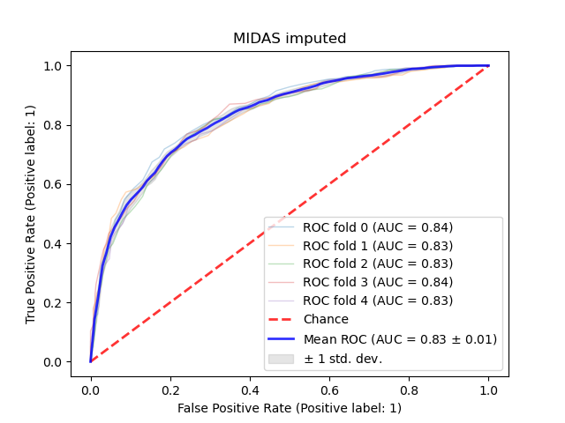
Random Forest (ROC Curve)

Slide 20
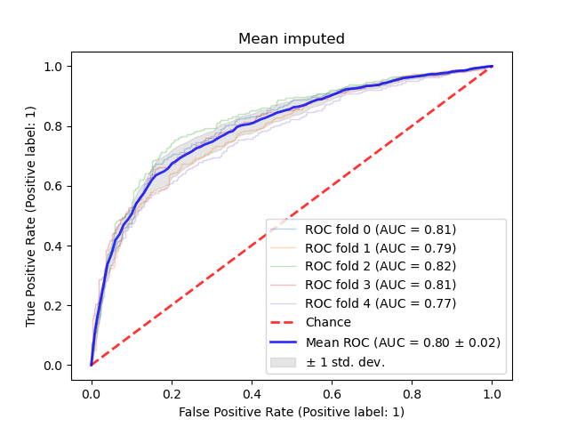
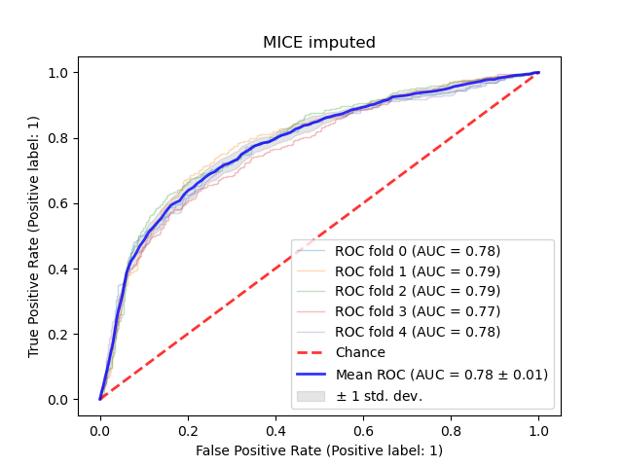
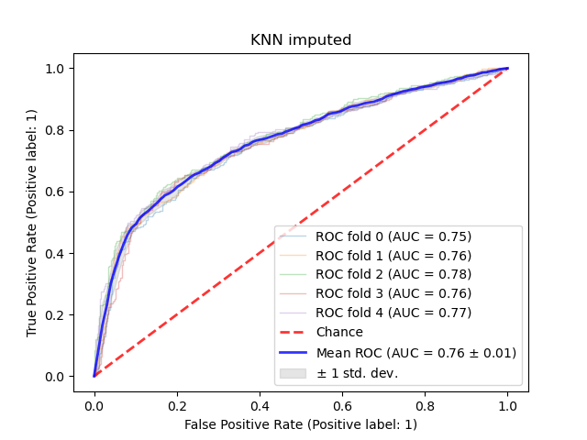
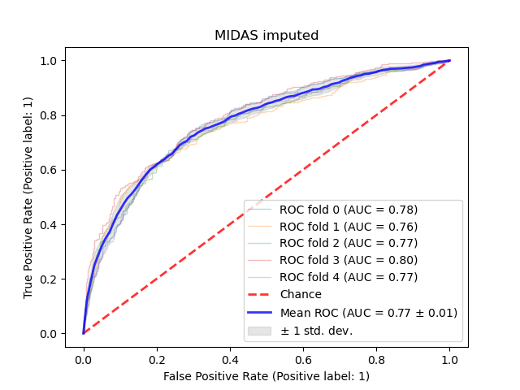
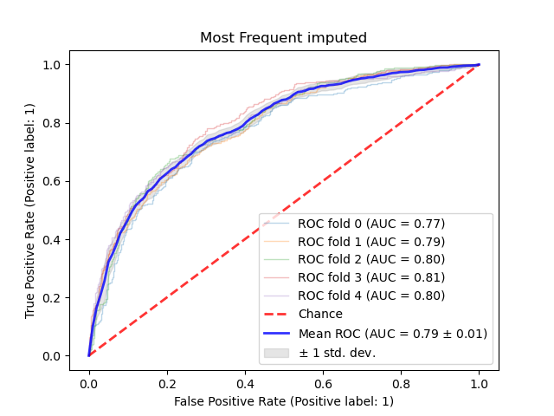
Support Vector Classification (ROC Curve)

Slide 21
\subsection{Correlation coefficient }
Pearson's formula:
\begin{equation*}
r =
\frac{ \sum_{i=1}^{n}(x_i-\bar{x})(y_i-\bar{y}) }{%
\sqrt{\sum_{i=1}^{n}(x_i-\bar{x})^2}\sqrt{\sum_{i=1}^{n}(y_i-\bar{y})^2}}
\end{equation*}
\[ r = \text{correlation coefficient}\]
\[x_{i} = \text{values of the x-variable in a sample}\]
\[\bar{x} = \text{mean of the values of the x-variable}\]
\[y_{i} = \text{values of the y-variable in a sample}\]
\[\bar{y} = \text{mean of the values of the y-variable}\]

